Slide 1
Daisyworld Law & Modeling
Evyatar, Ofri, Noa

Slide 2
Table of contents
01
03
02
Welcome to Daisyworld!
Evolution& natural Selection
Mathematical Model

Slide 3


01
Welcome to Daisyworld!

Slide 4
Introduction
The earth’s biota
Closely coupled system
The Gaia hypothesis

Slide 5

Parts of a daisy (world)
Cloudless
Only Daisies
2 types, black and white
Growth Rate
2D Model
Temperature senstive
Not a sphere

Slide 6
Advantages of Daisyworld
Earth
Daisyworld
VS
Complicated biota and environment
Simple biosphere
One environmental variable - temperature
Notes:
By simplifying our biosphere, we can describe it in terms of a few equations borrowed from population ecology theory. We are not trying to model the earth, but rather a fictional world which displays clearly a property which we believe is important

Slide 7
02
Mathematical Model

Slide 8

Let’s Talk About Equations!
$$\frac{dα}{dt}=α_{i}(x∗β_{i}−γ)$$
Daisy’s comperative growth rate
α – areas covered by black and white daisies
β – the growth rate of daisies per unit of time and area
x – area of fertile ground not covered by daisies
γ – the death rate per unit of time
Notes:
Alpha is iniallized to the maximum value between 0.01 and the equilibrium state at the last luminosity value simulated

Slide 9

Let’s Talk About Equations!
$$x=p − Σα_{i}$$
The area uncolonized by daisies
Σα – total area covered by black and white daisies
p – planet area
x – area of fertile ground not covered by daisies

Slide 10
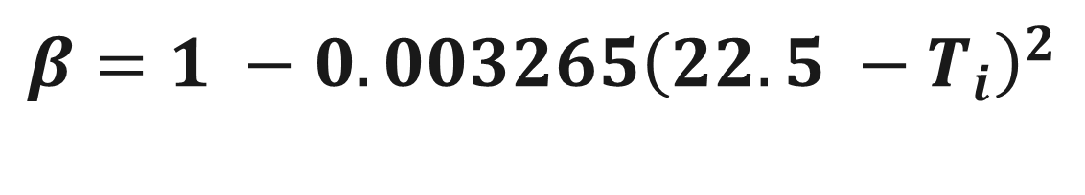
Let’s Talk About Equations!
$$β=1 −0.003265{\left(22.5 −T_{i}\right)}^{2}$$
Daisy’s growth rate
Parabolic function
T [c] – local temperature
T = 22.5 – maximum value of β
T < 5 or T > 40 – growth rate of zero

Slide 11
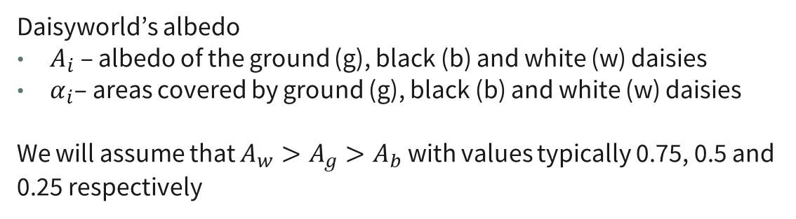
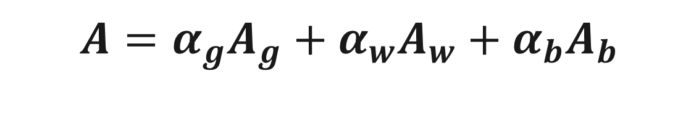
Let’s Talk About Equations!
$$A=α_{g}A_{g}+α_{w}A_{w}+α_{b}A_{b}$$
Daisyworld’s albedo
$A_{i}$ – albedo of the ground (g), black (b) and white (w) daisies
$α_{i}$– areas covered by ground (g), black (b) and white (w) daisies
We will assume that $A_{w}>A_{g}>A_{b}$ with values typically 0.75, 0.5 and 0.25 respectively
Notes:
Albedo!

Slide 12
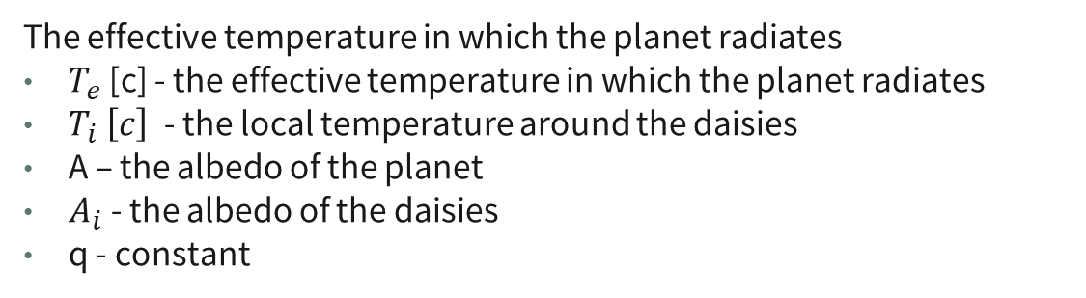

Let’s Talk About Equations!
$$T_{i}^{4}=q\left(A−A_{i}\right)+T_{e}^{4}$$
The effective temperature in which the planet radiates
$T_{e}$ [c] - the effective temperature in which the planet radiates
$T_{i} \left[c\right]$ - the local temperature around the daisies
A – the albedo of the planet
$A_{i}$ - the albedo of the daisies
q - constant
Notes:
Albedo!

Slide 13
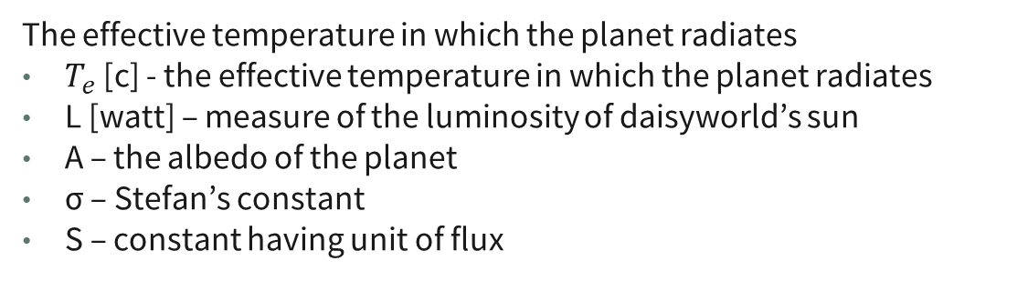

Let’s Talk About Equations!
$$σ{\left(T_{e}+273\right)}^{4}=SL(1−A)$$
The effective temperature in which the planet radiates
$T_{e}$ [c] - the effective temperature in which the planet radiates
L [watt] – measure of the luminosity of daisyworld’s sun
A – the albedo of the planet
σ – Stefan’s constant
S – constant having unit of flux
Notes:
Albedo!

Slide 14

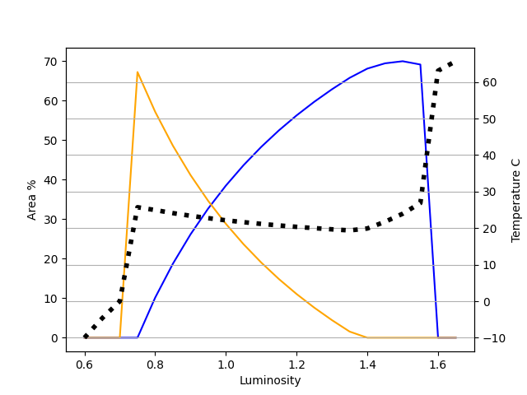
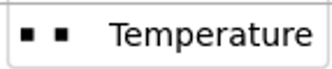
Graph Black&White Daisies

Slide 15
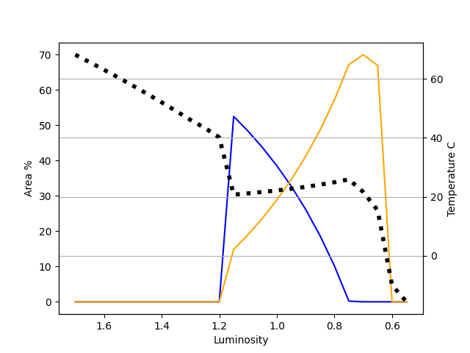
Decreasing Luminosity

Slide 16

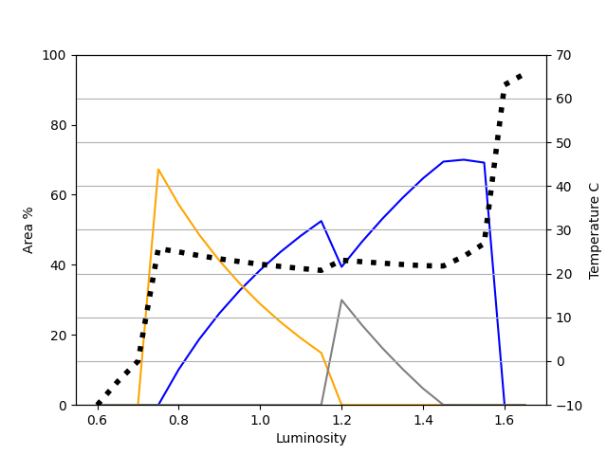
Extra Daisy

Slide 17
03
Evolution & Natural Selection

Slide 18
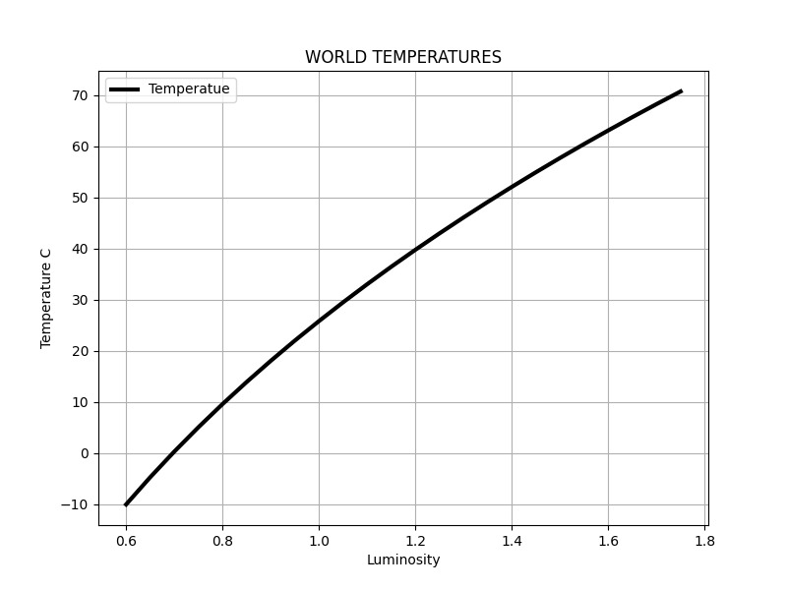
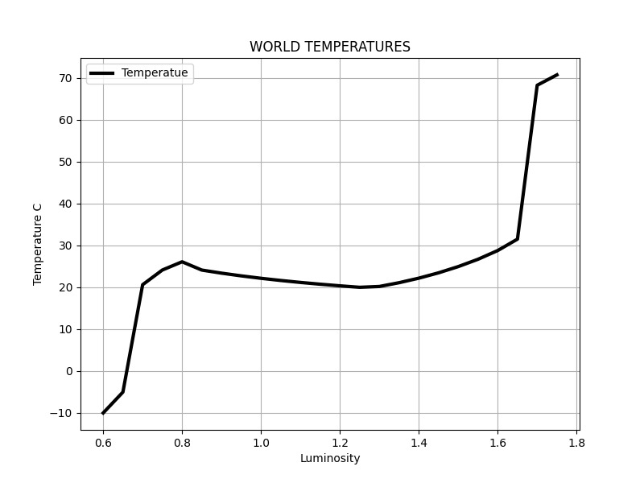
Imagine…
Two planets are orbiting a sun, whose luminosity is increasing
Daisy-free planet
Daisyworld

Slide 19
Natural Selection
What will happen if astronauts will arrive to Daisyworld?
Clear example of natural selection?
Of course not!
The daisies did not adapt to the environment, but rather adjusted the planet to suit themselves

Slide 20
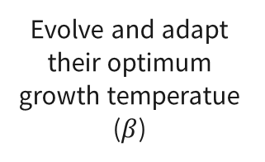
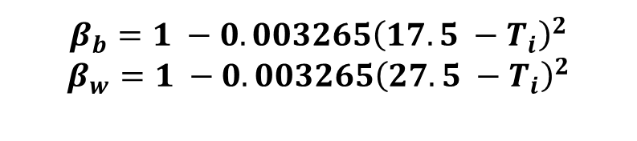
Darwinian Evolution on Daisyworld
Original daisies cover the planet
The adapted daisies will replace the original ones
Original: 0.63<L<1.58
Adapted: 0.68<L<1.48
Natural Selection
Initially
Robustness
01
02
03
04
05
Adaptaion
Area
Evolve and adapt their optimum growth temperatue ($β$)
$$β_{b}=1 −0.003265{\left(17.5 −T_{i}\right)}^{2}$$
$$β_{w}=1 −0.003265{\left(27.5 −T_{i}\right)}^{2}$$
67% → 70%
area covered by daisies

Slide 21
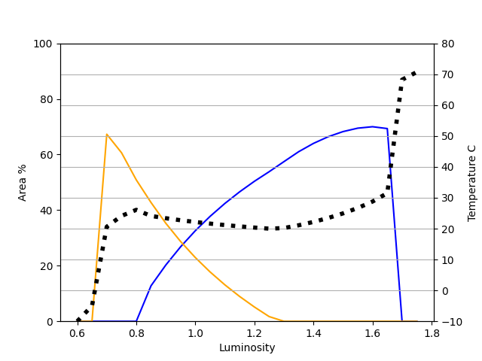
Darwinian Evolution on Daisyworld

Slide 22
Conclusions
A similar mechanism may play a part in regulating the earth’s biota
Demostration of a very simple system – null hypothesis
Asymetrical model – decreasing luminosity
Darwinian evolution may lead to higher population, at the expense of robustness
Notes:
We can speculate that such mechanisms may have played a part in regulating the temperature and other environmental variables over the long history of the earth

Slide 23
Resources
Articles
Watson, A.J.; J.E. Lovelock (1983): Biological homeostasis of the global environment: the parable of Daisyworld
Peter T. Saunders (1994): Evolution without Natural Selection: Further Implications of the Daisyworld Parable
Wood, A. J., Ackland, G. J., Dyke, J. G., Williams, H. T., & Lenton, T. M. (2008). Daisyworld: a review. Reviews of Geophysics, 46(1)

Slide 24
Questions?

Slide 25


Thanks!

